Slide 1
Ggplot2 and interactive graphics with R
Christophe Ladroue
SECTION 03
Conveying more information
www.PacktPub.com

Slide 2
In this section we’re going to take a look at
Using group and colour
Using size and colour
Minimizing overplotting with jitter
Faceting with 1 variable
Faceting with 2 variables

Slide 3
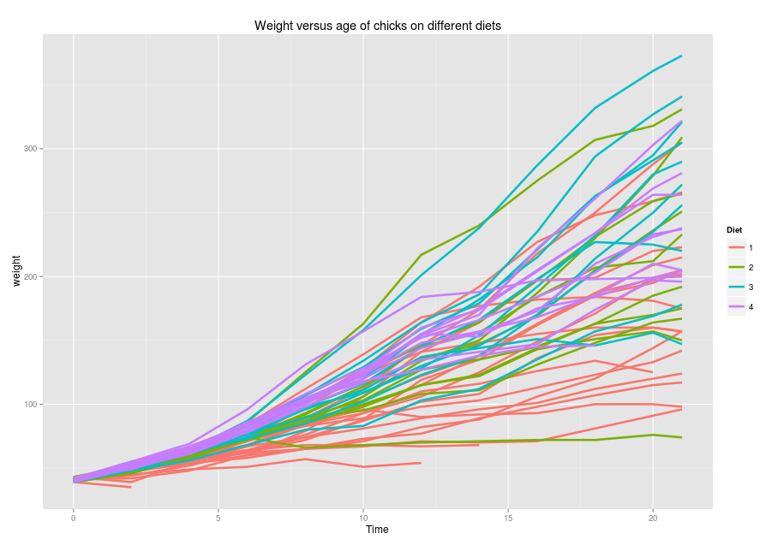
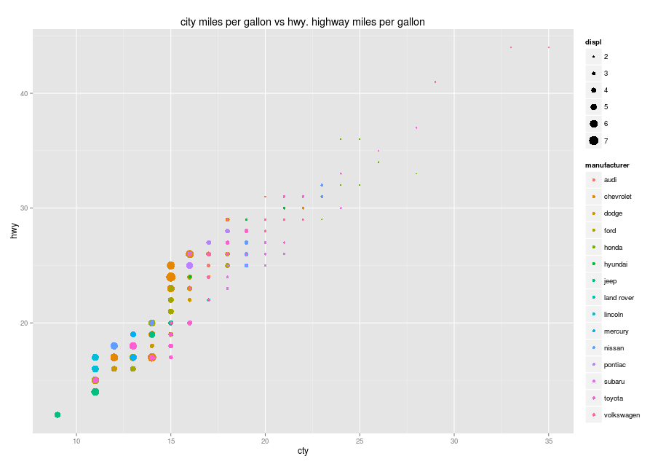
In this video we took a look at
The dataset Chickweight
How to use the aesthetics group and colour to convey more information.
Next: using size and colour

